Slide 2

From CDISC ARS to Production:
Implementation of Metadata-Driven TLF Automation
Zou Qing 邹庆
Statistical Programming and Analytics Reporting

Slide 3




DISCLAIMER
This presentation is intended to facilitate knowledge exchange.
The views expressed in this presentation are those of the presenters and do not necessarily reflect the views of Sanofi.
Sanofi does not recommend the use of its products in any manner inconsistent with that described in the local package insert.
Before using any product mentioned here-in please refer to the full local prescribing information.

Slide 4

Agenda
CDISC ARS overview
Implementation for Schema, UI, and Code Gen
Takeaway
Notes:
industry standard, analysis need, and registration regulation

Slide 5



TLF generation process
Generation in TLFs
Evolution in TLFs
Designing shells in static documents
Adoption of open-source programming
languages (rtables, tplyr, gtsummary)
Writing custom algorithms per study
digitalize
Interactive reporting tools(Teal, safetyGraphics)
automation
Modifying on template code
efficiency
CDISC release Analysis Results Standards (2024)
Managing low reusability across teams
Notes:
industry standard, analysis need, and registration regulation

Slide 6
TLF generation process
Generation in TLFs
Evolution in TLFs
Designing shells in static documents
Adoption of open-source programming
languages (rtables, tplyr, gtsummary)
Writing custom algorithms per study
digitalize
Interactive reporting tools(Teal, safetyGraphics)
automation
Modifying on template code
efficiency
CDISC release Analysis Results Standards (2024)
Managing low reusability across teams
Notes:
industry standard, analysis need, and registration regulation

Slide 7
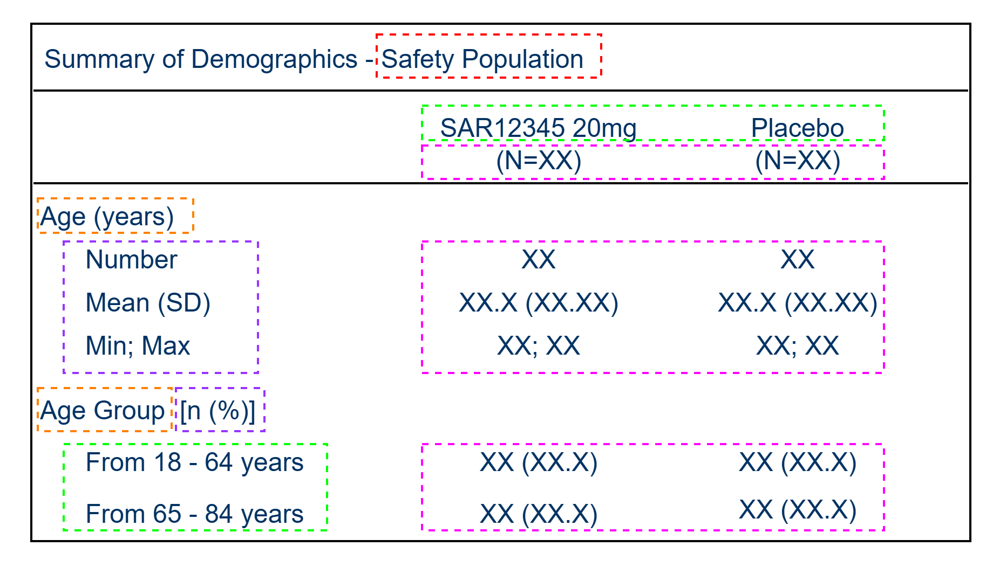
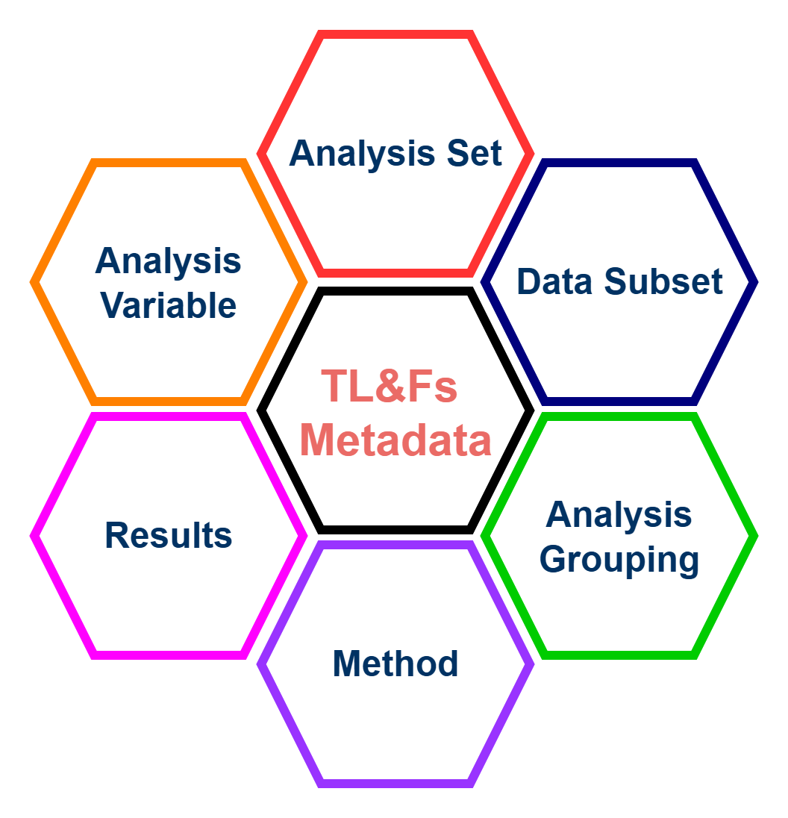
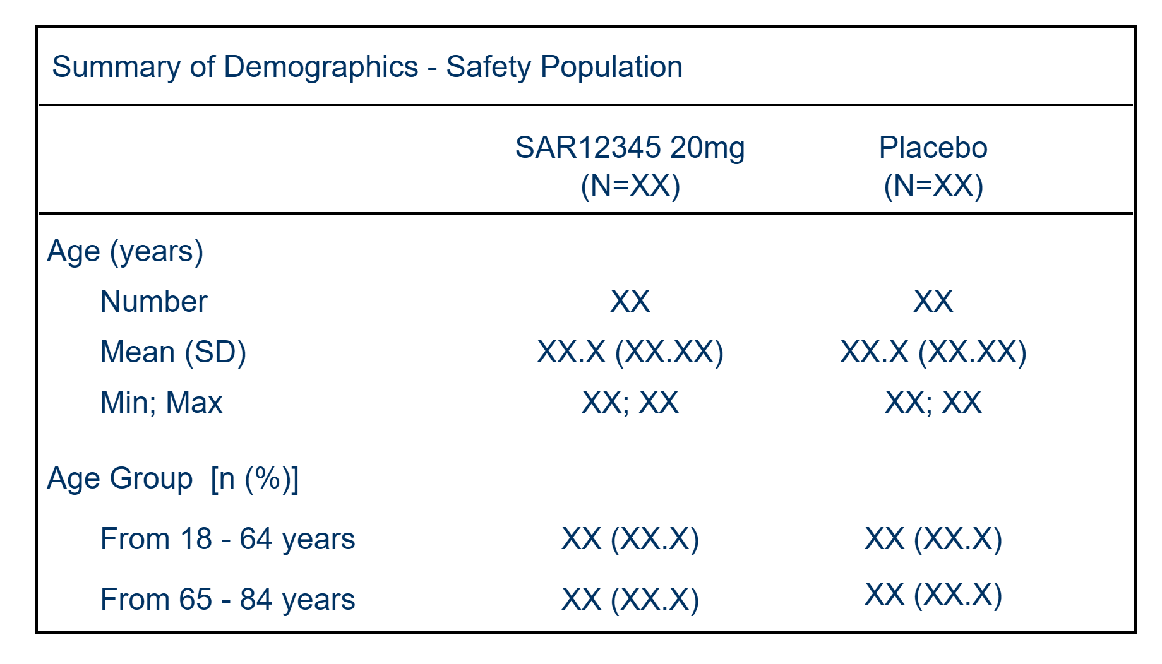
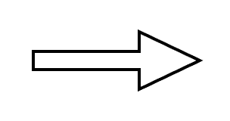
CDISC Analysis Results Standards(ARS)
Standard:
A logical data model(TLF Metadata)
establishes the structure to represent
the analysis results as standard data
Integration:
End-to-end data analysis workflow
(CRF -> SDTM ->ADaM –> ARS)
Automation:
Use standard metadata to drive
the automation of analysis result

Slide 8
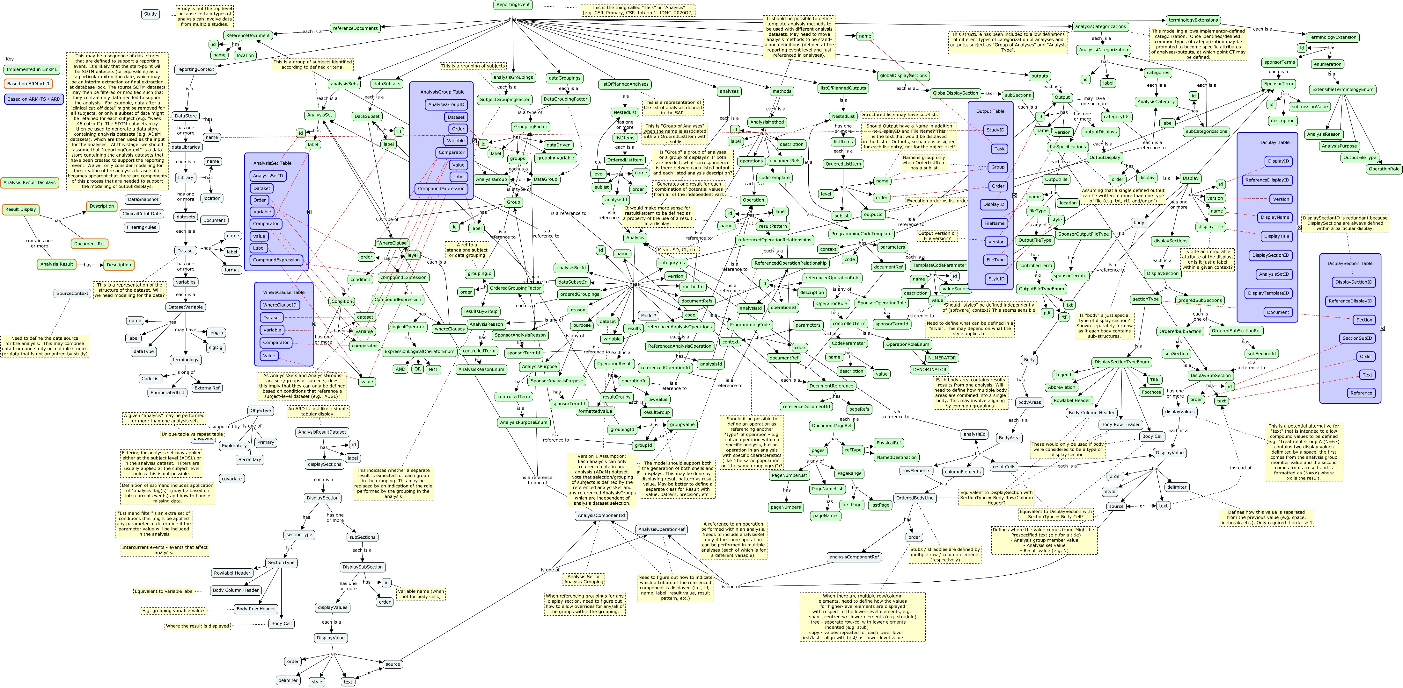

CDISC Analysis Results Standards(ARS)
Standard:
A logical data model(TLF Metadata)
establishes the structure to represent
the analysis results as standard data
Integration:
End-to-end data analysis workflow
(CRF -> SDTM ->ADaM –> ARS)
Automation:
Use standard metadata to drive
the automation of analysis result
How to
use it?

Slide 9
CDISC Analysis Results Standards(ARS)
Standard:
A logical data model(TLF Metadata)
establishes the structure to represent
the analysis results as standard data
Integration:
End-to-end data analysis workflow
(CRF -> SDTM ->ADaM –> ARS)
Automation:
Use standard metadata to drive
the automation of analysis result
ARS is conceptual and purposely streamlined for ARD
No TLF layout specifications that transform ARD to well formatted TLFs
No code generation or ARD production tool
Steep learning curve for non-ARS-expert due to complicated schema

Slide 10
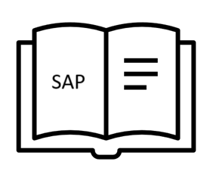


Metadata-Driven TLF generation process
SDTM/ADaM metadata
= *automated process
Production requirements
TLF application*
Mock-Shell Designer
TLF metadata
Output metadata
TLF Metadata Schema Extension
UI/UX for Application
Analysis Output Metadata representation
E2E from TLF design to TLF generation
Annotated TLF shells
ARD
Code Gen
Output
Code Gen
ADaM
Analysis
Results
Dataset
(ARD)
SDTM
CT
Individual formatted
& submission ready TLFs

Slide 11
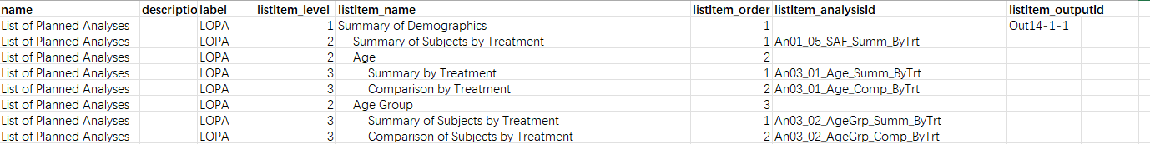
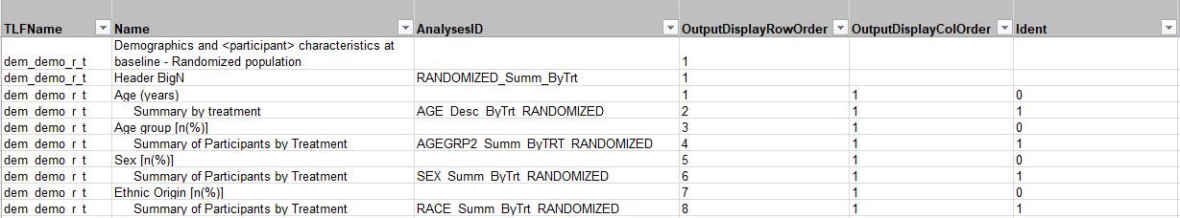
TLF Metadata Schema Extension
Extended schema provides the structural foundation for all mock shell requirements
ARS – List of PlannedAnalyses:

Slide 12
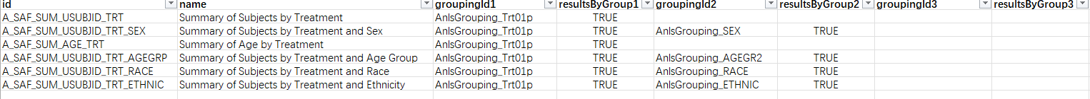
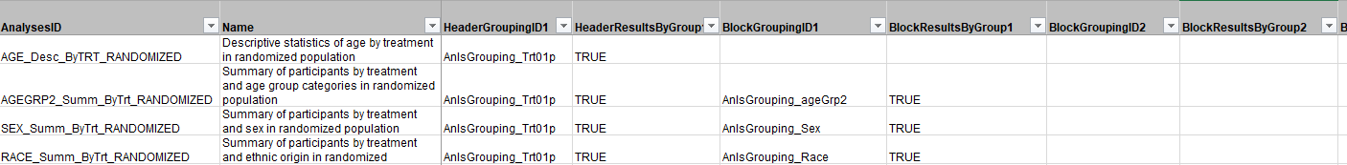
TLF Metadata Schema Extension
ARS – Analyses:
column level
row level

Slide 13
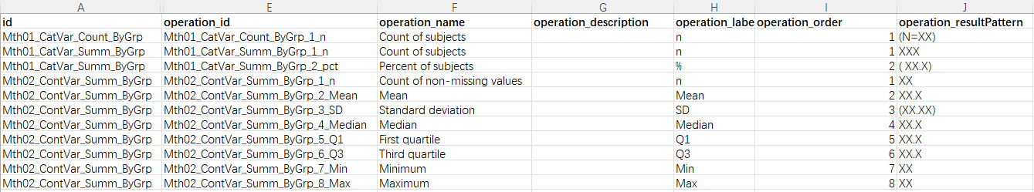
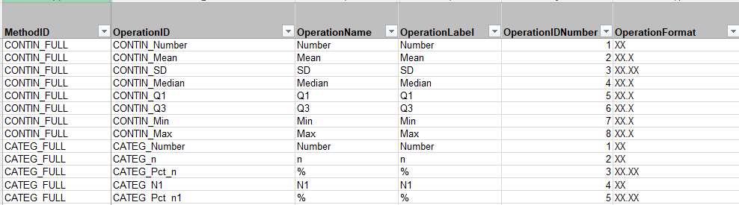
TLF Metadata Schema Extension
ARS – AnalysisMethod:

Slide 14
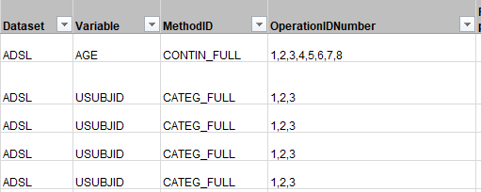
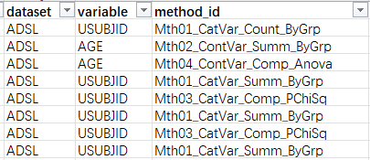
TLF Metadata Schema Extension
ARS – Analyses:

Slide 15
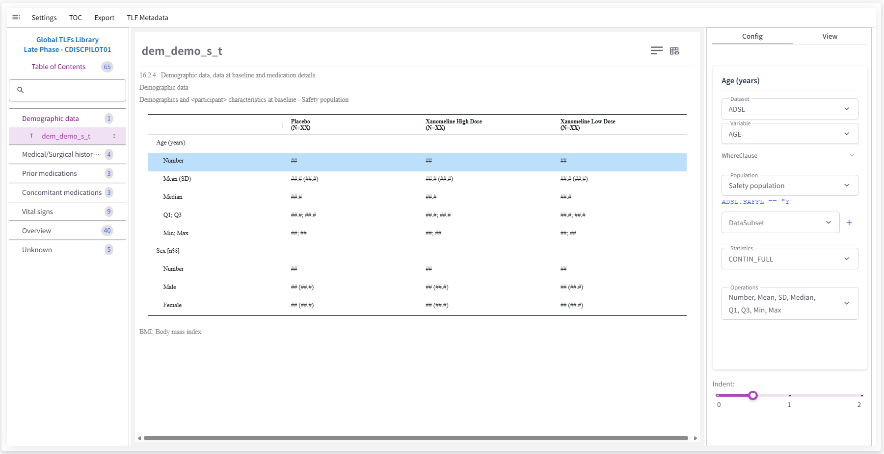
Mock shell designer
establishes logical connections between shell and TLF Metadata

Slide 16
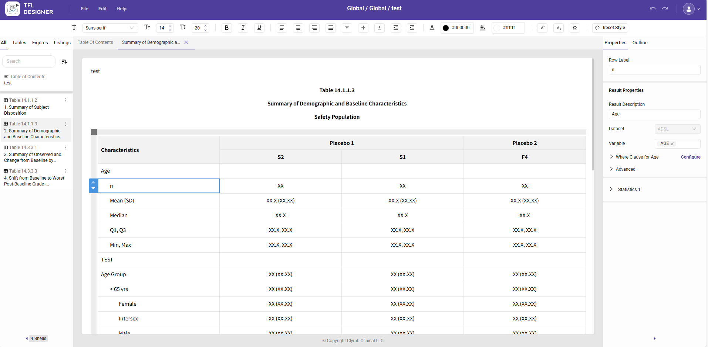
Mock shell designer
establishes logical connections between shell and TLF Metadata
Clymb Clinical:TFL Designer

Slide 17
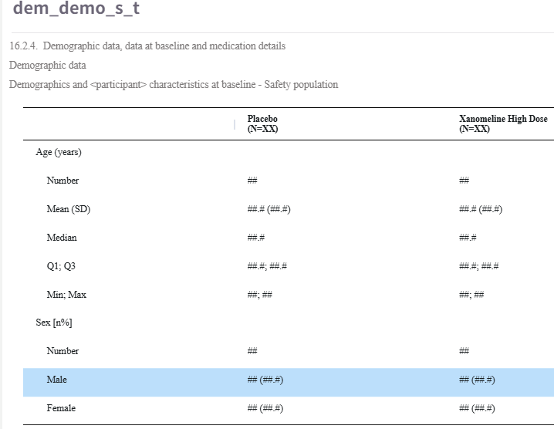
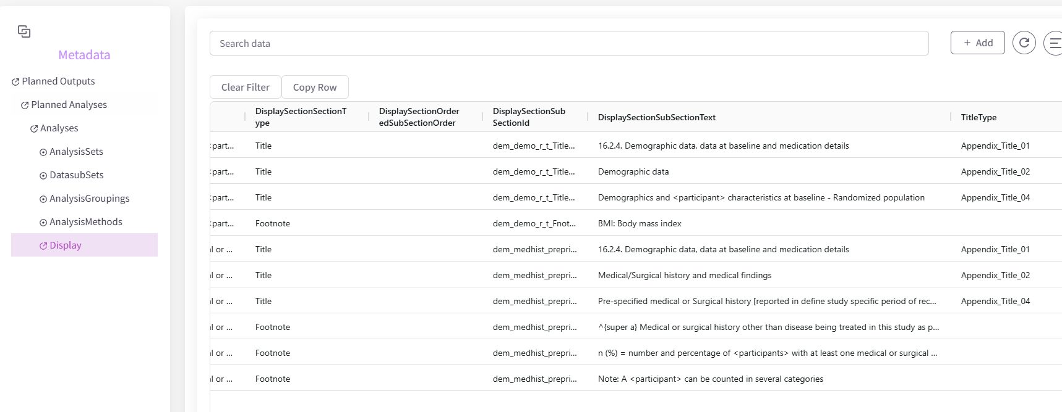
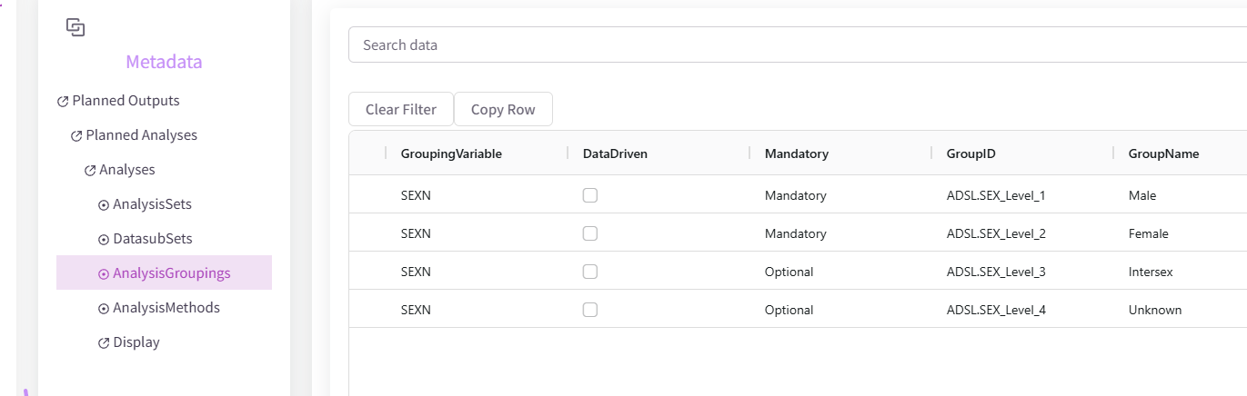
Mock shell designer
INTERNAL USE

Slide 18
Mock shell designer
Balancing ARS model complexity with user accessibility
- How to keep the flexibility to add or remove analyses
- Abstraction layer in UI hides complexity

Slide 19
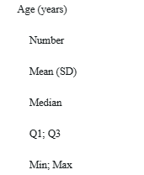
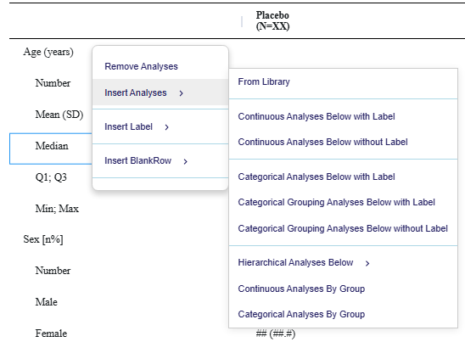
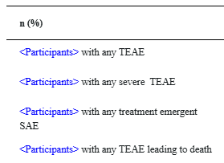
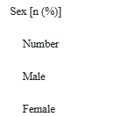
Mock shell designer
Context menu on rows: Extract Analysis types from tables
Continuous Analyses with Label
Categorical Analyses with Label
Categorical Grouping Analyses with Label

Slide 20
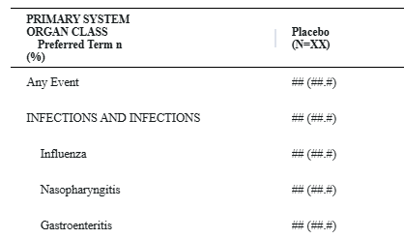
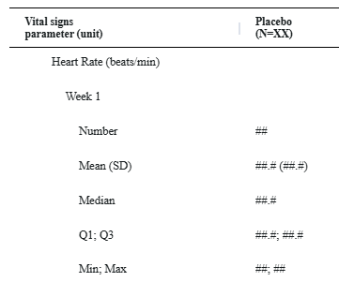
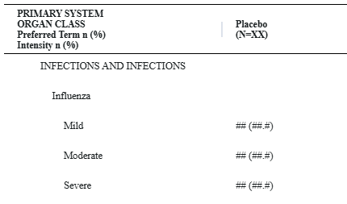
Mock shell designer
Context menu on rows: Extract Analysis types from tables
Hierarchical Analyses
Continuous Analyses by Group
Categorical Analyses by Group
More and more types?

Slide 21
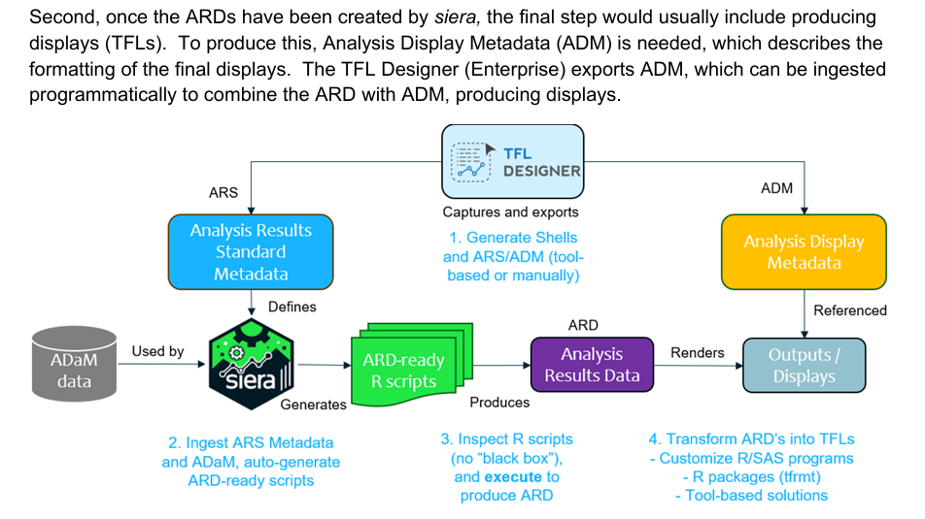
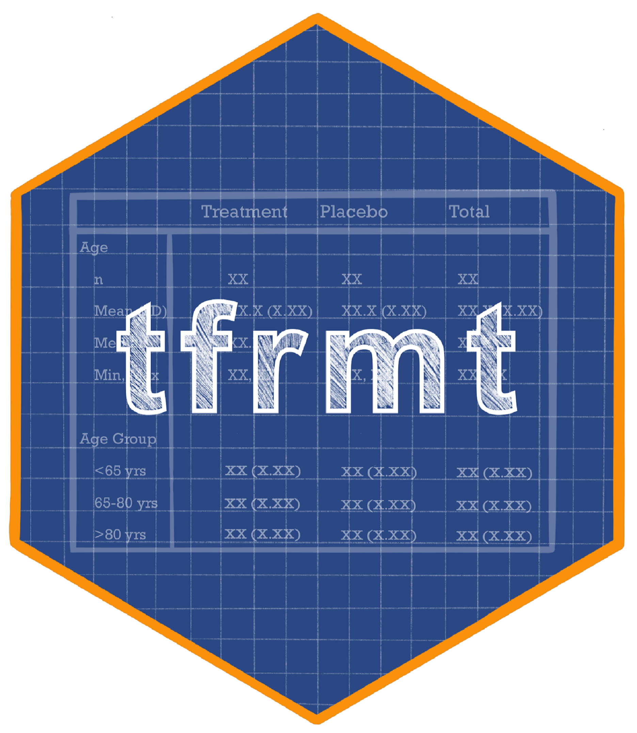
Analysis Output Metadata
ARD -> Output: layout, results
template_json <- json_to_tfrmt(
path = "template.JSON")
from
Clymb Clinical

Slide 22
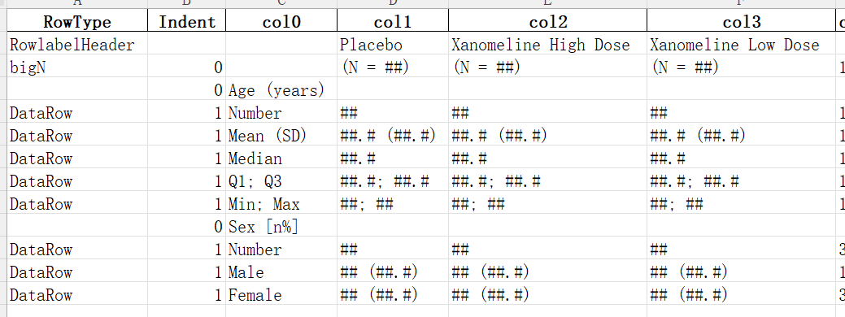
Analysis Output Metadata
Export mock shell from app

Slide 23
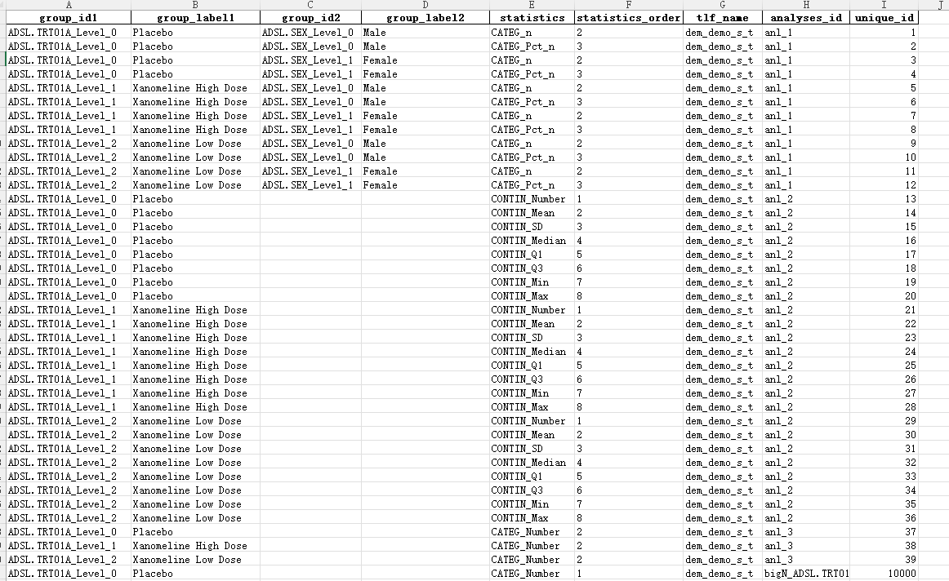
Analysis Output Metadata
Backend: ARD shell mock shell

Slide 24
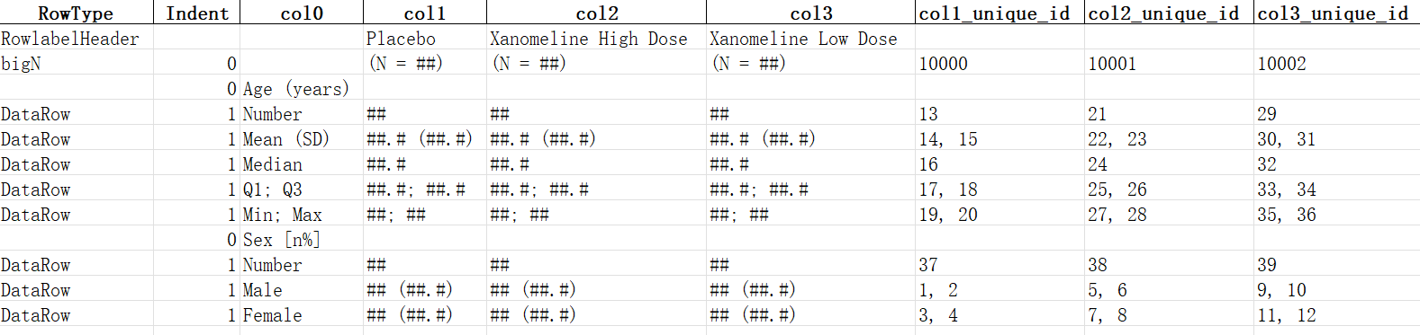
Analysis Output Metadata
Build Linkage between ARD and output layout by the unique_id
R code is for ARD calculation only; no layout logic required.

Slide 25
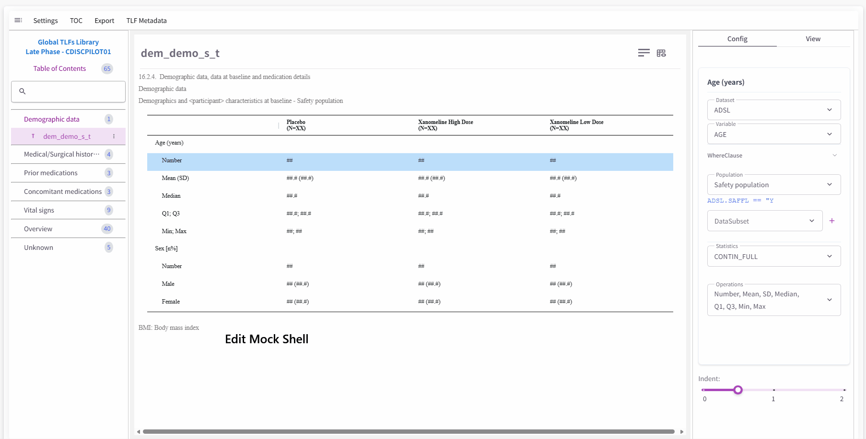
TLF Generation Process

Slide 26
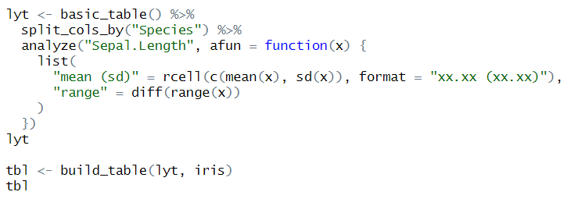
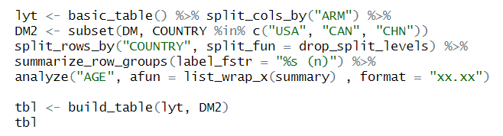
TLF Generation Process
Define/Choose Mock shell: layout, TLF Metadata annotation
Export TLF MD, ARD Shell, AOM, Mock shell document
ADaM/SDTM
Dataset
Code gen
ARD
Output
Consistent with existing R workflows:

Slide 27
Summary
TLF Metadata
Adapt and refine the existing structure in alignment with company standards
Extend schema provides the structural foundation for table layout requirements,
maybe AI metadata infrastructure requirements
UI/UX
Focus on synchronizing and establishing the connection between Mock Shell
and TLF Metadata
Cover diverse table types early in the design process
Build for Programmer(statisticians) without requiring deep ARS knowledge
Analysis Output Metadata
Leverage the existing mock shell layout from the UI to configure the most
efficient layout for downstream R programming
Multiple options available — select the most suitable approach based on the existing toolset/library
Notes:
TLF Metadata
1. 根据公司standard适量修改或改造原有的结构
2. Extended schema provides the structural foundation for table layout requirements
UI/UX
1. Focus在Mock shell与TLF Metadata如何同步, 建立连接
2. Built for Programmer(statisticians) without requiring deep ARS knowledge
Analysis Output Metadata
1. 利用已有的UI中的mock shell layout实现对后续R programming最有效率的layout配置
2. 选项很多，根据已有的工具库选择合适的方案

Slide 28




TLF Standard MD & Application Development Journey
TLF Metadata
Completed
Upcoming
Sept 2023
April 2024
June 2025
Dec 2025
2026 Q2
Cliquez sur l'icône pour ajouter une image
Kick-off
CDISC ARS released
1.0 Release
2.0 Release
Integrate ARS with Sanofi specifics
Digitalize standard shell
ARD-TLF App
90% Feature Complete
July 2024
Oct 2024
Sept 2025
2026 Q1
2026 Q2
Cliquez sur l'icône pour ajouter une image
Pilot Study
Kick-off
TFL Designer released
Go live
Build Database
Table Shell and TLF MD creation
ARD Code generation(R)

Slide 29
Thank You

